Slide 1

REAL HACK
Hierarchical UI to view LAND PLOTS
Aslam abbas
Sebastian Thomas
Shyjal raazi
Ibrahim M T

Slide 2
Objective
Helping users find plots faster and easier
Get complete information regarding the plot
Plot the land with help of GPS in mobile

Slide 3
Hierarchical UI

Slide 4
Hierarchical UI

Slide 5
Hierarchical UI

Slide 6
Hierarchical UI

Slide 7
View Plot information
Data | Advantage
Plot shape and size | Buyer can know if the shape is ideal for their purpose
Water level | Compare with other plots
Disaster History | “same as above”
Safety issue | “same as above”
Future Growth | Investors require this info
Amenities available | Availability of necessary amenities can reduce future costs

Slide 8
Android App
Using GPS , mark the boundaries of the plot
Also capture images and upload them to site
Seller can add further details in the Web App

Slide 9
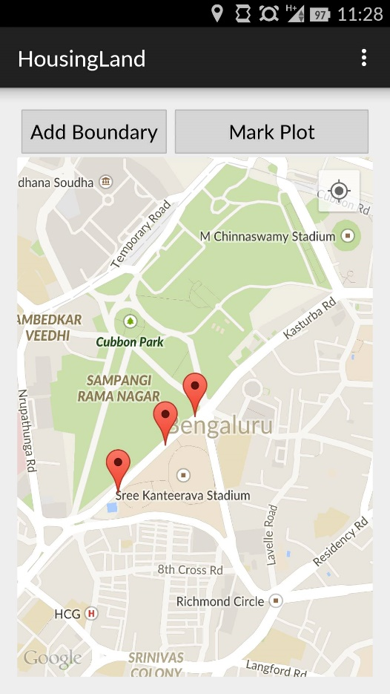
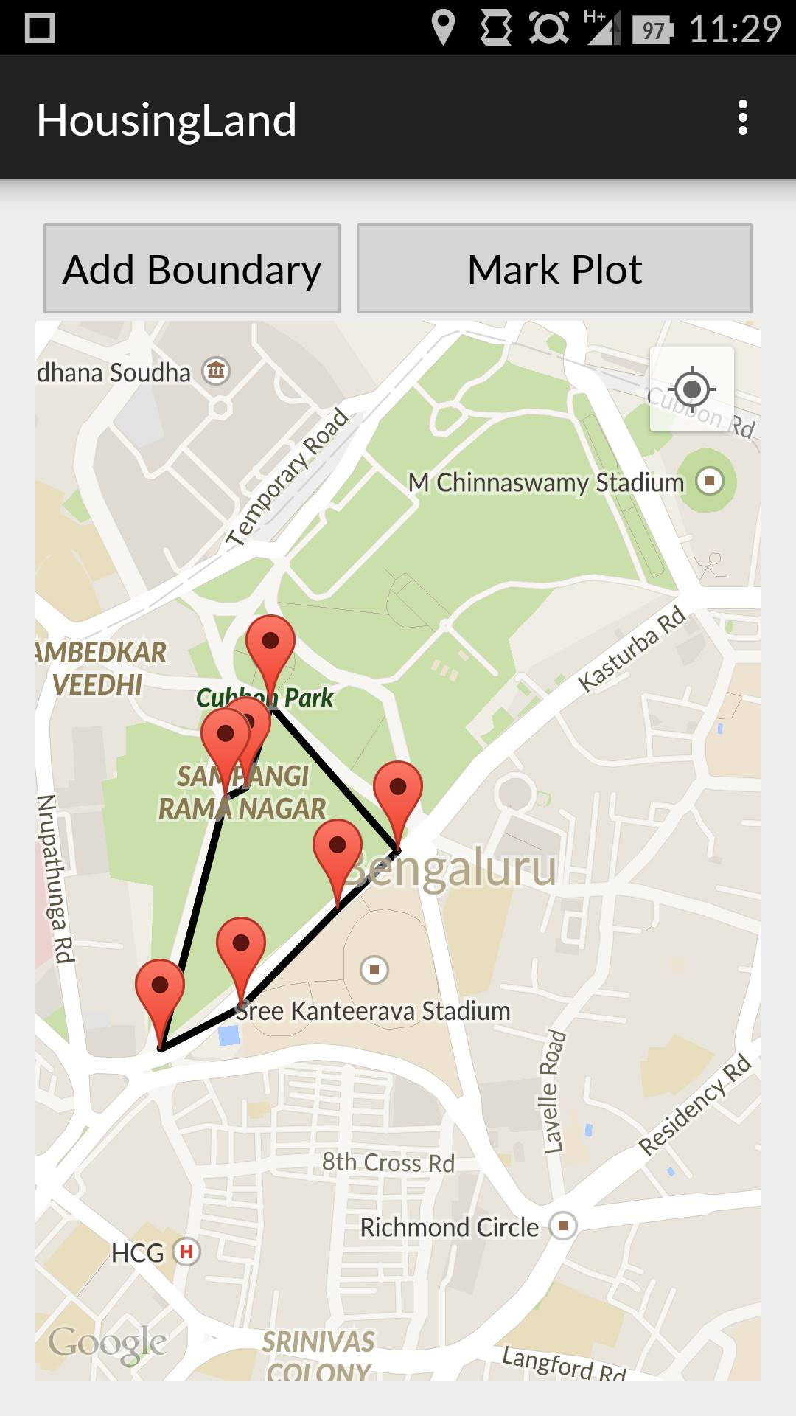
Android App

Slide 10
THANK YOU

